Slide 1
Samsung Innovation Campus
Artificial Intelligence Course
Notes:
Note:
1

Slide 2
Employee Future Prediction
Project presented by :
Marwan Mohamed
Marwan Makhlouf
Mohamed Sameh
Facilitator:-
Eng. shimaa Othman
Data Used : Employee Future Prediction(Kaggle)
Notes:
Note:
2

Slide 3
Agenda
1- About Data
2- Preprocessing
3- EDA and Data Visualization
4- ML Model
5- Business Solution
Notes:
Note:
3

Slide 4
About data
A company's HR department wants to predict whether some employees would leave the company in next 2 years.
Our job:-
Is to build a predictive model that predicts the prospects of future and present employees.

Slide 5
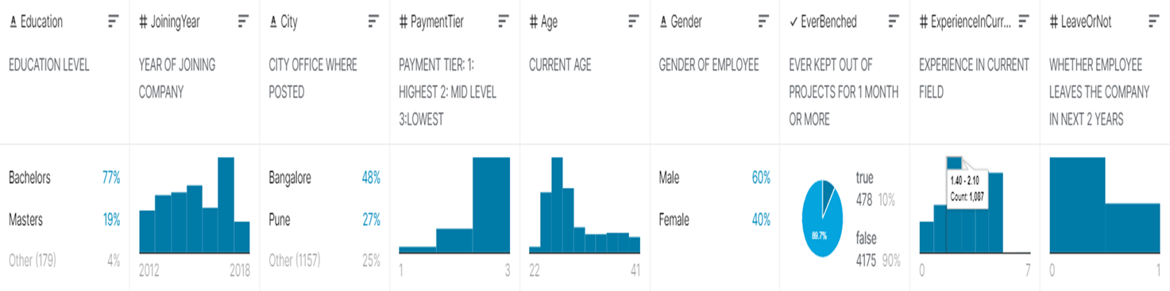
Data Features:

Slide 6
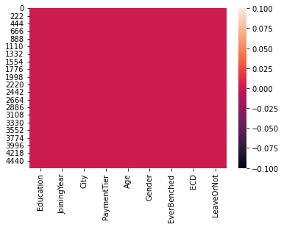
Preprocessing
Duplicated
No missing values

Slide 7
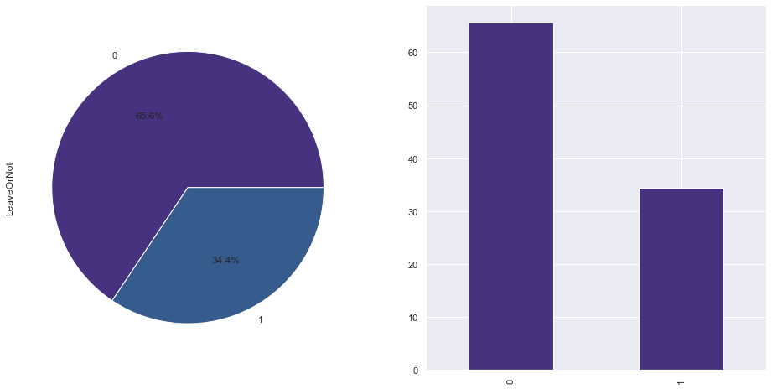

Treating the imbalance in target

Slide 8
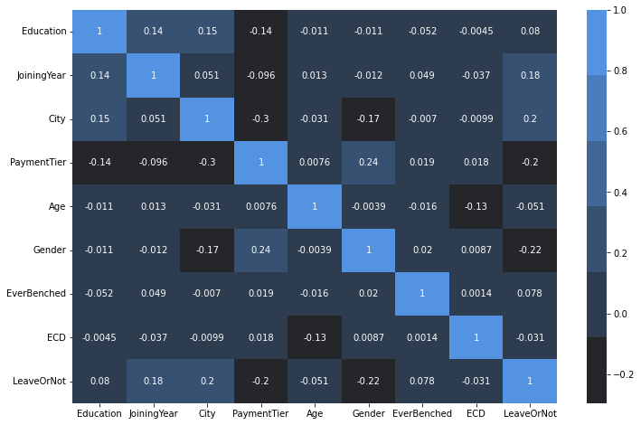
EDA & Visualization
Correlation is very weak between features

Slide 9
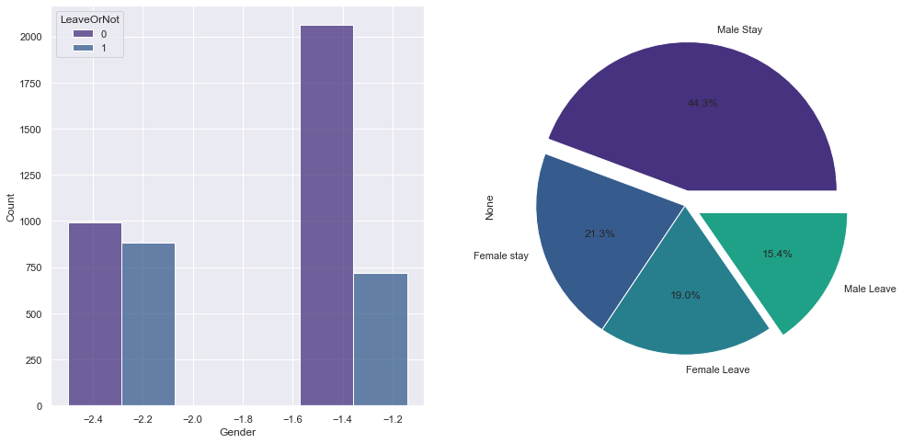
Male >>> 44% staying, 15% leaving
Female >>> 21% staying, 19% leaving

Slide 10
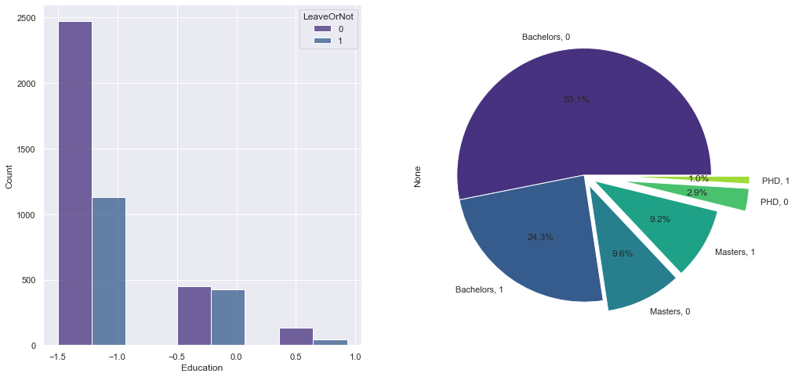
Bachelors >>> 53% Staying , 24% leaving
Master >>> 9.6% leaving, 9.2% staying

Slide 11
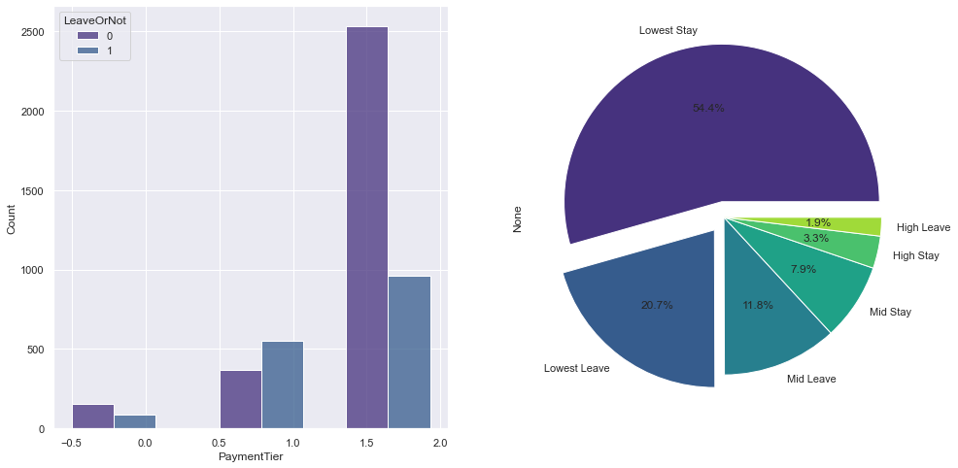
The type of payment tier
-1: HIGHEST -2: MID LEVEL -3:LOWEST
tier payment >>> the lowest 54% staying ,20% leaving

Slide 12
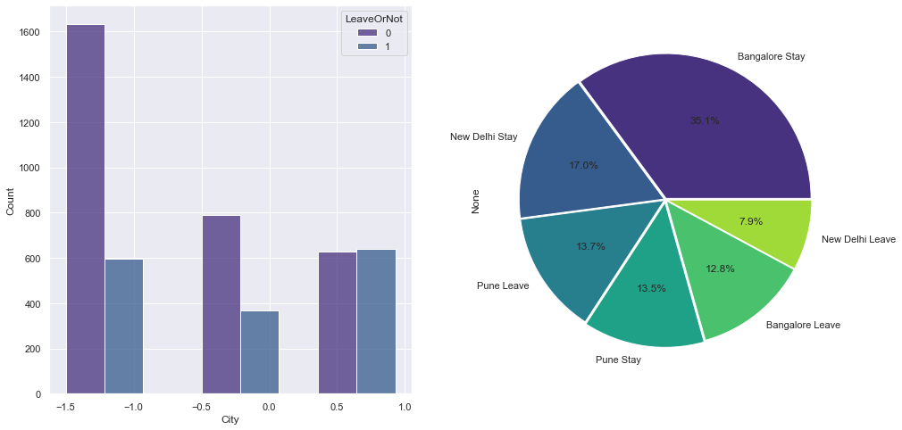
Bangalore >>> 12.8% leaving
New Delhi >>> 8% leaving

Slide 13
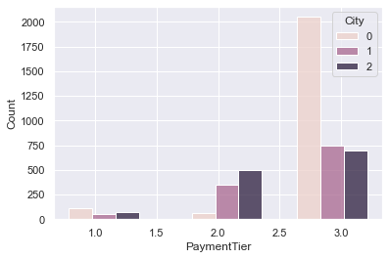

Slide 14
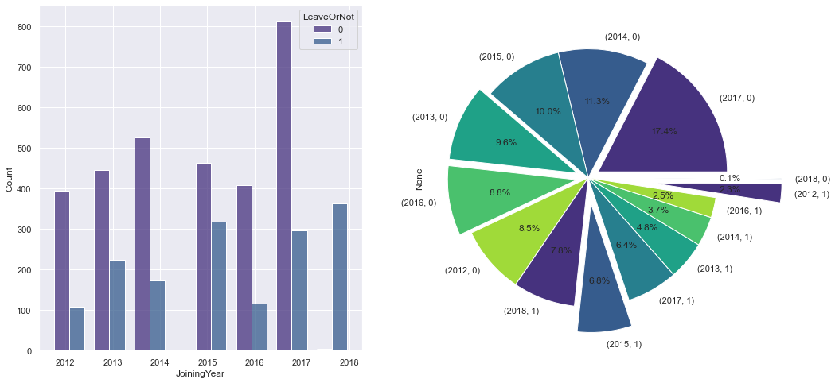
2018 >>> all in 2017 leaving
2012, 2016 is the lowest year

Slide 15
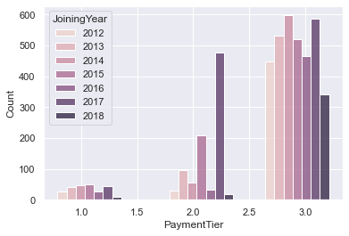

Slide 16
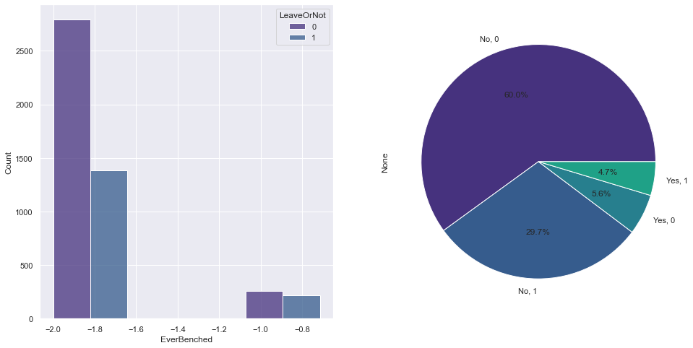
30% from not behanced leaving
5.6% behanced and not leaving

Slide 17
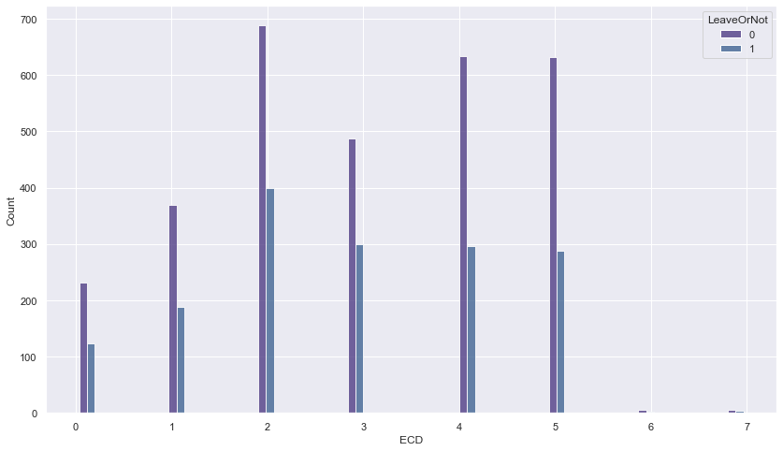
2years exp. >>> highest in staying and leaving

Slide 18
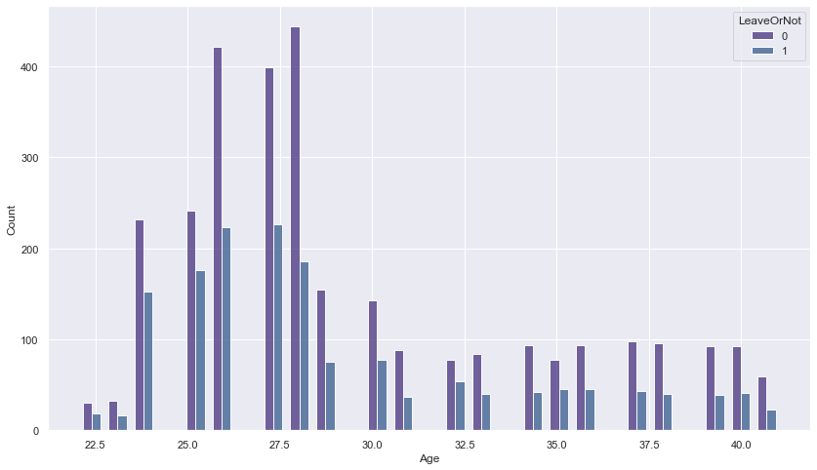
28 years is the highest and lowest in leaving and staying

Slide 19
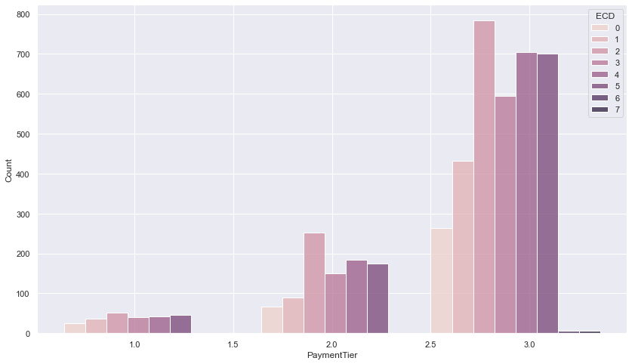

Slide 20
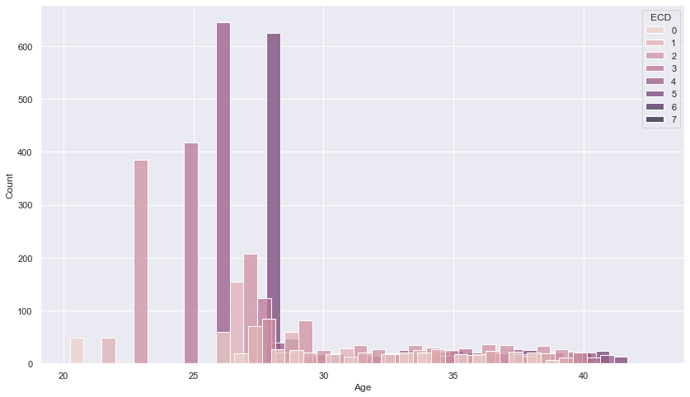

Slide 21
Modeling
Model | Accuracy (X&Y_Train) | Accuracy (X&Y_Test)
LGBM KNN Decision Tree Random Forest Gradient Boosting SVM Extra Trees | 88.5% 82.4% 84.69% 84.2% 85.5% 83.7% 86.7% | 88.4% 82.3% 84.60% 84.1% 85.4% 83.6% 86.6%

Slide 22
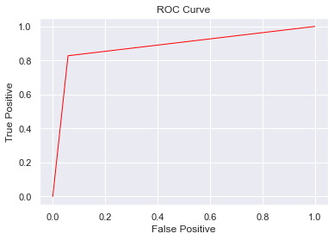
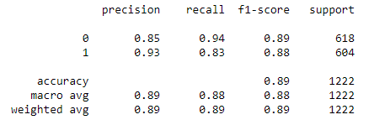
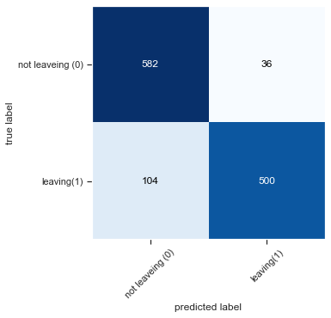
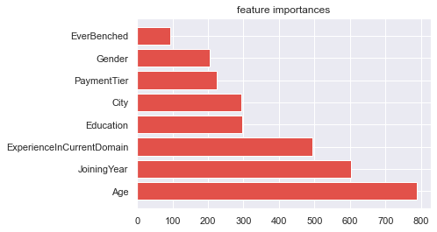
LGBM Classifier
Acc: %88.5

Slide 23
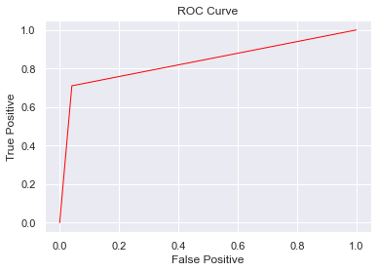
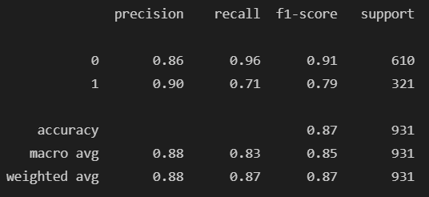
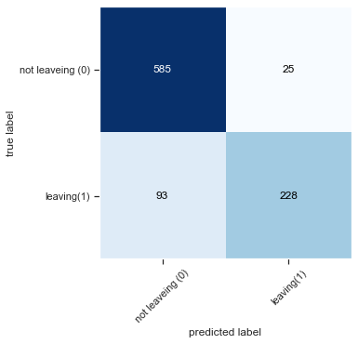
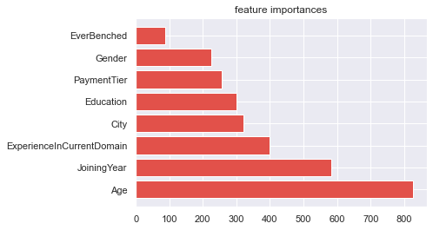
LGBM Classifier
Acc: %87.32

Slide 24
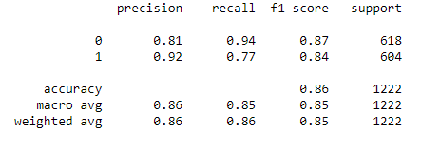
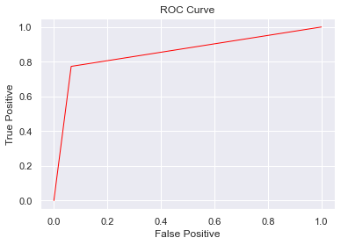
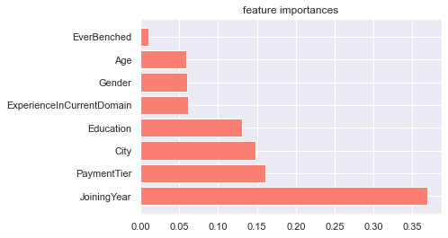
Gradient Boosting
Accuracy: 85.5%

Slide 25
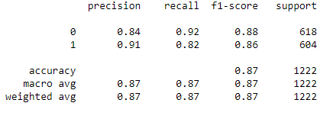

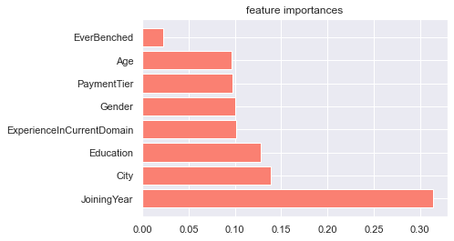
Extra Trees
Accuracy: %86. 7

Slide 26
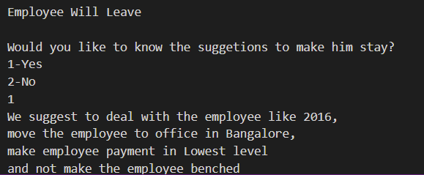
Solution

Slide 27
Thank You

